Slide 1
Workshop on Workshops or Teaching Yourself a Thing

Slide 2
Plan
Frame next assignment
Discuss concept behind it
Share and work through Brandon's example lesson
Discuss Critical Digital Pedagogy

Slide 3
Workshop Assignment
Due November 28th
Use it as an opportunity to teach to learn.
Develop a low-tech, pencil and paper (ish) digital humanities workshop you could give soon based on your research interests.
Work with each other (and/or staff) to workshop your individual workshop materials.
Outcome will be a blog post
Notes:
Other questions that should be asked?

Slide 4
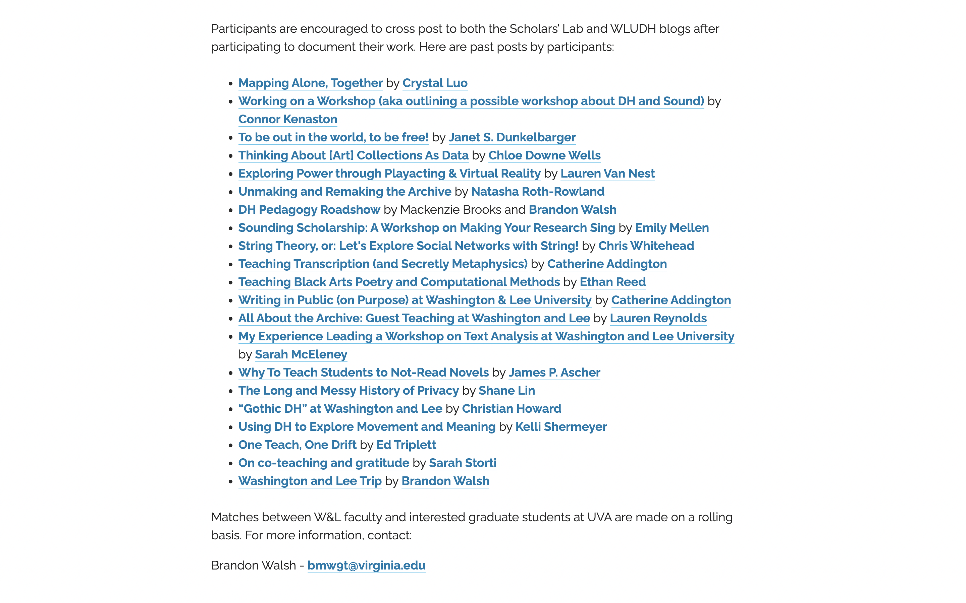

Slide 5
Buttonology
"Knowing how to upload texts into a tool like Voyant does not help researchers think about what texts should be uploaded, how selecting data relates to a research question, or even what constitutes an effective research question."
"Beyond Buttonology: Digital Humanities, Digital Pedagogy, and the ACRL Framework" – John E. Russell and Merinda Kaye Hensley
That's the provocation for this unit.
Notes:
Reactions to the buttonology reading?
What are the worst teaching/learning experiences they've ever had?
What scares them about teaching digital humanities?
Things you want them to get to – it's ok not to know everything. The technology can get in the way; it's not always necessary; you only need to know a little bit. They're all good teachers.
Buttonology certainly has its place, but there are other ways to teach.

Slide 6
Example Workshop – Ways to Read a Text
One-shot workshop that I can use for variable amounts of time
Uses basically no technology but powerpoint
Basically it's text analysis with pen and paper
In what follows, you’ll get a micro-version of the workshop and then we’ll reflect on the pedagogy behind it together
Can find it written up here - https://walshbr.com/blog/ways-to-read/

Slide 7
Embedded Workshop Starts here
Slides start here!
At this point in the original iteration, I had already introduced:
Close reading (literary interpretation by paying attention to the text)
Bag of words approaches to texts (basically just issues in word counting as a computer would do it)
Now moving into how a computer can do more complicated forms of analysis.
But also works as a standalone

Slide 8
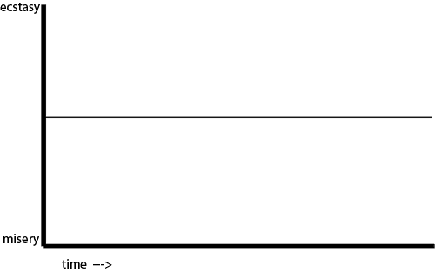
https://sive.rs/drama
Notes:
In Kurt Vonnegut’s masters’s thesis gave postulated that all stories are about moving between happiness and sadness over time, ecstasy and misery. He also returned to this idea in later lectures.

Slide 9
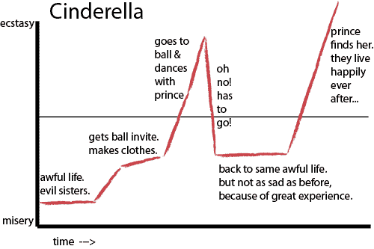
Notes:
Here he plots out cinderella. Along with certain key plot points that track to the story. He somewhat famously offered several of these plot archs as archetypes and said something like “there are six types of stories”

Slide 10
Sentiment Analysis
But how does a text convey feeling?
Is it happy? Sad? Positive or negative?
Complicated questions!
Let’s try to tell with simple examples…
Notes:
This is a convenient thing for us because as you’ve been seeing in codelab, computers are very literally minded. You give them some information and they work with it. Given their constraints, how can we get to complex ideas like human emotions. How can a computer help us understand things.
We’ll be working with this provocation today and combining it with some of our codelab work. How does a text convey feelings? How does a computer understand things?

Slide 11
Sentiment Analysis
“I am very happy.”
“She is so sad.”
Notes:
Are these sentences happy or sad? How do you tell?

Slide 12
Sentiment Analysis
"It was the best of times, it was the worst of times…”
Notes:
Happy? Sad? How do you tell? Maybe there’s some other kind of measure?

Slide 13
Sentiment Analysis
"It was the best of times, it was the worst of times…”
Not a clear answer overall. If we can’t tell, how would a computer?
We need a better way to register this. Let’s go word by word.
Notes:
Happy? Sad? How do you tell? Maybe there’s some other kind of measure?

Slide 14
Sentiment Analysis
"It
was
the
best happy! / positive
of
times,
it
was
the
worst sad! / negative
of
times…"
Notes:
But remember computers like numbers. How might we register this?

Slide 15
Sentiment Analysis
"It
was
the
best happy! / positive / 1
of
times,
it
was
the
worst sad! / negative / -1
of
times…"

Slide 16
Sentiment Analysis
"It was the best of times, it was the worst of times…”
1 -1
Total = 0
Overall neutral sentiment?
So we can get at the emotional score of a sentence, by
a) assigning values to +/- words and b) counting up those values
Notes:
If we add up the numbers for the sentence, we can get a sense of the feelings in it.

Slide 17
Sentiment Analysis
Glance at the excerpts on your handout and think about them in this way.
Which do you expect to be happiest? Saddest?
Do this mathematical charting for at least one of the paragraphs.
What problems or questions does this raise?
Do in pairs
Notes:
Note in particular that Fahrenheit 451 appears to be the happiest.
Key concepts to point them towards:
How do they move from individual words to whole paragraphs' sentiment?
How do they compare or not the sentiment of each others? They need to have the same common number system
They need a dictionary of words that have sentiments
Does every word have a polarity associated with it?
What about context? How would you account for context?
Anything else?

Slide 18
Sentiment Analysis
Can imagine a range of emotions: good, better, best.
So you could use a range of numbers: good = +1, better= +3, best = +5
Say, assign any emotion-laden word a number between -5 and +5.
Keep in mind that you’re not reading for context. Simply on a word-by-word basis.
So “yes” would be positive. “no” would be negative
Notes:
Points that might come up?

Slide 19
Sentiment Analysis
How do we account for context?
How do we make sure our results are comparable?
How can we make sure everyone is getting the same results so that we could compare readings?
How do you account for longer texts?

Slide 20
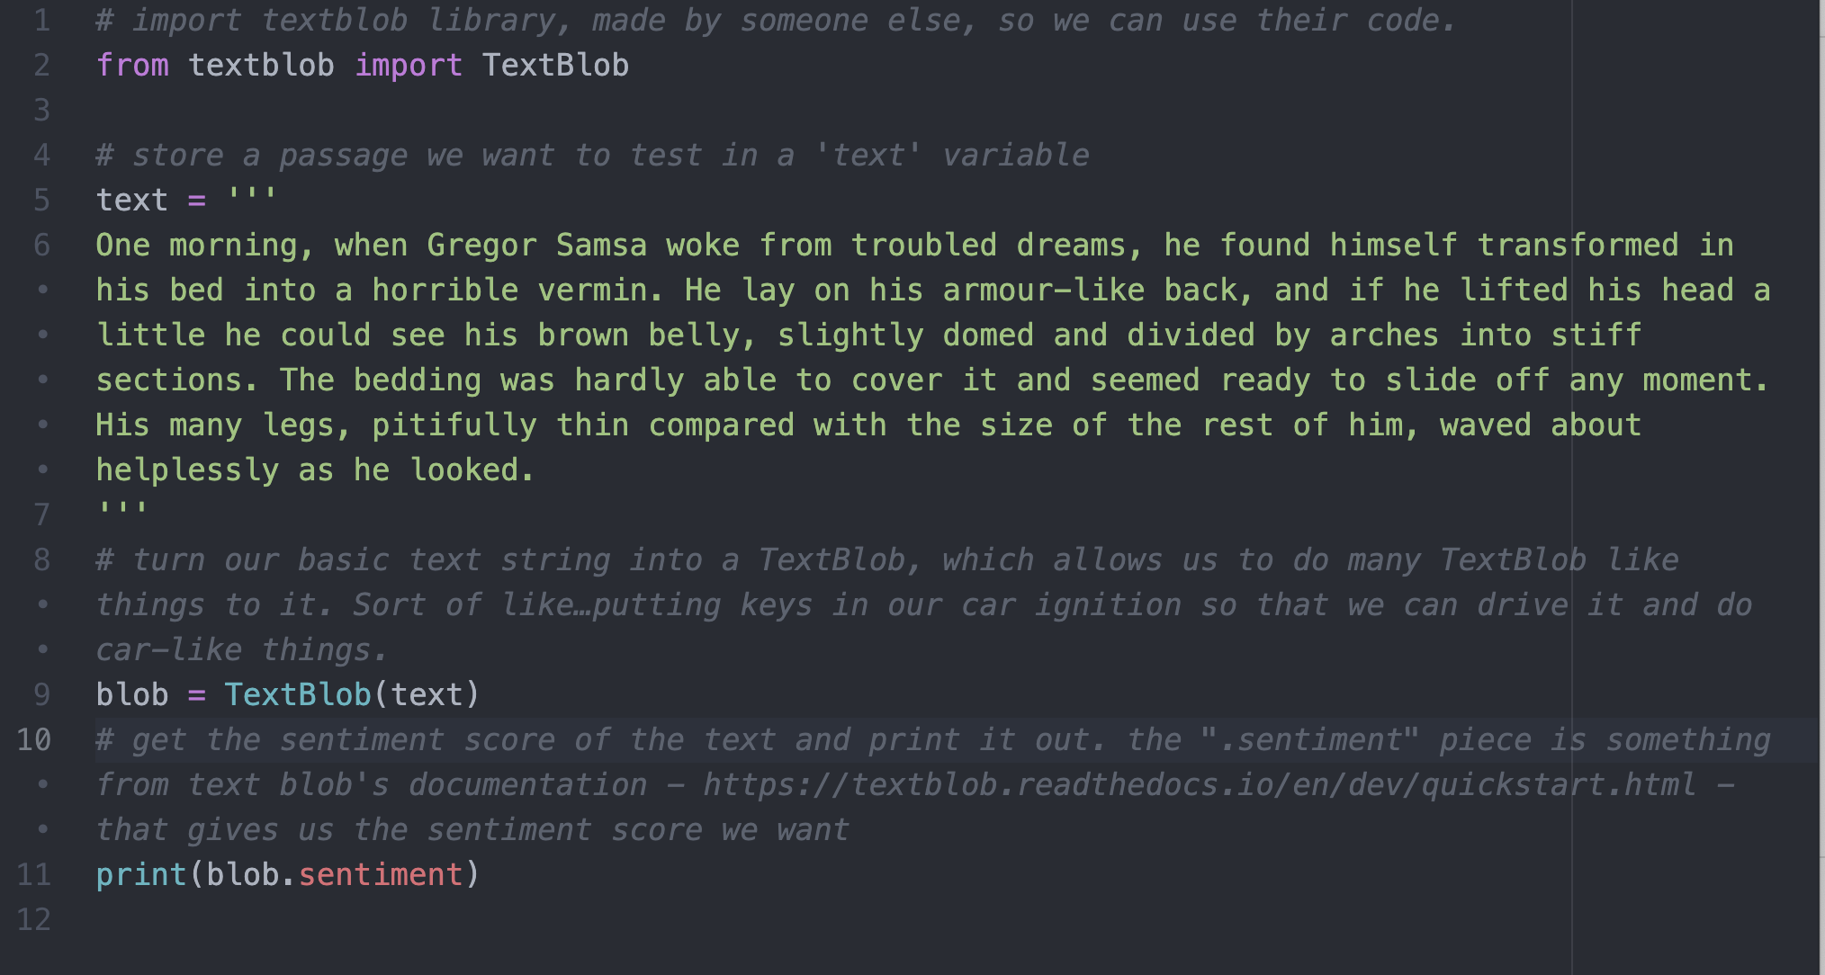

Slide 21
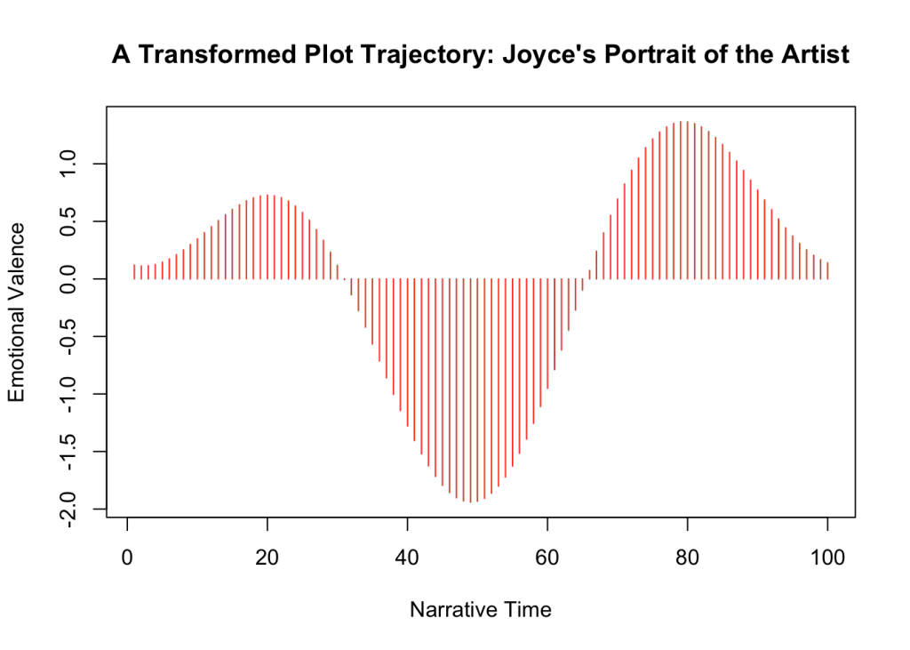
Sentiment Analysis in Use
http://www.matthewjockers.net/2015/02/02/syuzhet/
Notes:
What can you do with sentiment analysis?
From a humanities perspective, you can say that by registering moments of happiness or sadness over time, you can measure a plot’s tension. You could get a sense of the plot arc in a text. Jockers claims there are really only six shapes if you do this kind of math.

Slide 22
Reflect on the Activity
General thoughts on what we did.
Thoughts on other technical workshops they've been in.
Thoughts on the readings.

Slide 23
Reflect on the Activity
Low risk of technical problems going wrong
Students don't need any programming to participate
Gets concepts across but the students arrive at them on their own
Now they'll know what the tools are doing, which removes one element of confusion when learning technical tasks.
Show them where to go next

Slide 24
Workshop Assignment
Due Week of November 28th
Develop a low-tech, pencil and paper (ish) digital humanities workshop you could give soon based on your research interests.
Use it as an opportunity to teach to learn.
Work with others on your ideas
Outcome is a blog post

Slide 25
Homework
Think about what kind of method or concept you want as part of your profile
Think through how it might relate to your own…
Research
Workshop
Start brainstorming workshop ideas.
Talk to me – I can poke you in a direction

Slide 26


Slide 27
Getting Started Monday
Going to be talking with Mackenzie Brooks from Washington and Lee
Come with a couple questions each for her about DH and teaching, DH work at a SLAC, etc. based on your reading and experiences thusfar.
Explore 2-3 categories in Digital Pedagogy in the Humanities: Concepts, Models, and Experiments that are useful for your interests and use them to begin thinking about your workshops.

